Slide 1

HOSTEL FINDER

Slide 2
01
Zeya Khan
MEMBERS
210543181051
02
Vishal Pawar
210543181070

Slide 3

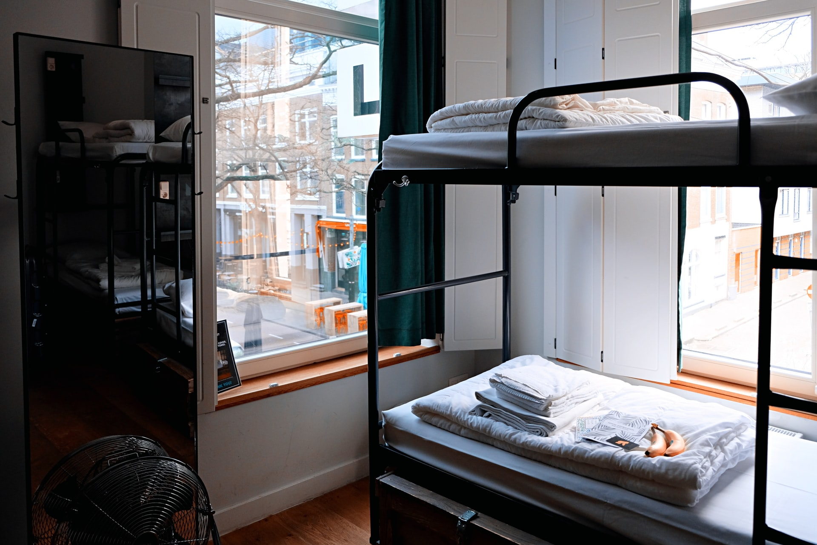





HOSTEL FINDER

Slide 4
01
Problem Statement
Hostel Finder

Slide 5

Problem Statement
Now a days it is very difficult for an individual especially students and graduates who start their carrier in their respective field to move from their native place to the place where they have to work or complete their studies. There are so many difficulties like lack of knowledge of that respected area, language boundary, locality etc

Slide 6
02
Objectives
Hostel Finder

Slide 7

Objectives
To reduce efforts of the individual
01
For Student/Employee
To help the Students or Employee to Find Hostel in new and unknown area Easily and Efficiently
02
For Hostel Owners
To give the Boost to Local Hostel Business and to Provide an online Platform to there Business.

Slide 8


Objectives
To make satisfied decision regarding the hostel
01
Parents or guardian satisfaction is also considered
Students or Employees don’t have to visit Hostels ,They can see all the information and picture regardin hostel and nearby area online and then they can tack decision
02
Parents or guardian will be assured about there childs Safety and Living , in new area

Slide 9

Objectives
Finance stability is also maintained
Students or Employees can rent hostel and pay the rents through secure payment getway method , And rent will be directly deposited in Owners Bank Account

Slide 10
03
Work Flow
Hostel Finder

Slide 11
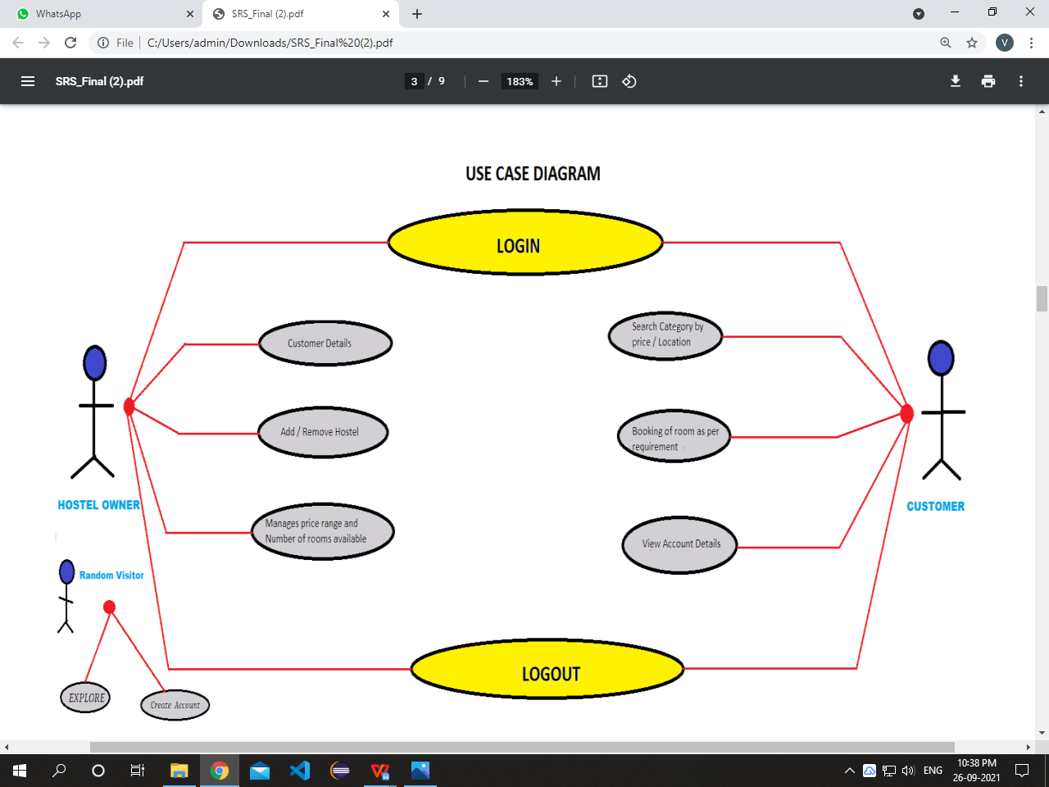
WorkFlow

Slide 12
04
Modules
Hostel Finder

Slide 13
Modules
Admin
Student/Employee
Hostel Owner
Admin Account
Customer Account
Owner Account
Admin has privilege to control all the sytem.
Admin can accsess and modify all the data of users
Admin can add new data.
Admin can block user and there account.
Cutomer can search and sort data according his/her requirment.
Customer can book the room.
Customer can pay for the room by online payment.
Customer can access his/her account details
Owner can add or remove hostel.
Owner can add or remove details of room for that hostel.
Owner can manage the pricing and availability of room.
Owner can access his/her account details.

Slide 14
05
Database Tables & ER Digram
Hostel Finder

Slide 15
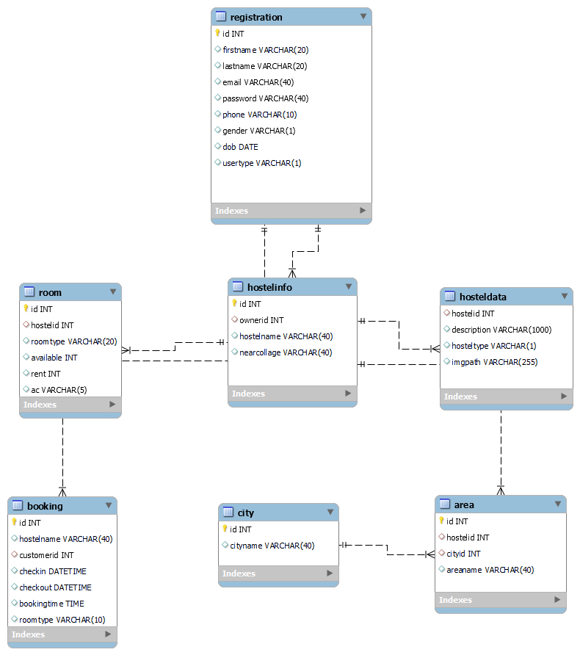
Database Tables & ER Digram

Slide 16
Database Tables & ER Digram
Table name : registration
Column name | Type
Id | int | NO | PRI | auto_increment
firstname | varchar(20) | YES
lastname | varchar(20) | YES
email | varchar(40) | YES
password | varchar(40) | YES
phone | varchar(10) | YES
gender | varchar(1) | YES
dob | datetime | YES

Slide 17
Database Tables & ER Digram
Table name: hostelinfo
Column name | Type
Id | int | NO | PRI | auto_increment
firstname | varchar(20) | YES
lastname | varchar(20) | YES
email | varchar(40) | YES

Slide 18
Database Tables & ER Digram
Table name: hosteldata
Column name | Type
hostelid | int | YES
description | varchar(1000) | YES
hosteltype | varchar(1) | YES
imgpath | varchar(255) | YES

Slide 19
Database Tables & ER Digram
Table name: area
Column name | Type
id | int | NO | PRI
hostelid | int | YES | MUL
cityid | int | YES | MUL
areaname | varchar(40) | YES

Slide 20
Database Tables & ER Digram
Table name : city
Column name | Type
id | int | NO | PRI
cityname | varchar(40) | YES

Slide 21
Database Tables & ER Digram
Table name : room
Column name | Type
id | int | NO | PRI
hostelid | int | YES | MUL
roomtype | varchar(20) | YES
available | int | YES
rent | int | YES
ac | varchar(5) | YES

Slide 22
Database Tables & ER Digram
Table name : booking
Column name | Type
id | int | NO | PRI
hostelname | varchar(40) | YES
customerid | int | YES | MUL
checkin | datetime | YES
checkout | datetime | YES
bookingtime | time | YES
roomtype | varchar(10) | YES

Slide 23
06
Home Pages
Hostel Finder

Slide 24
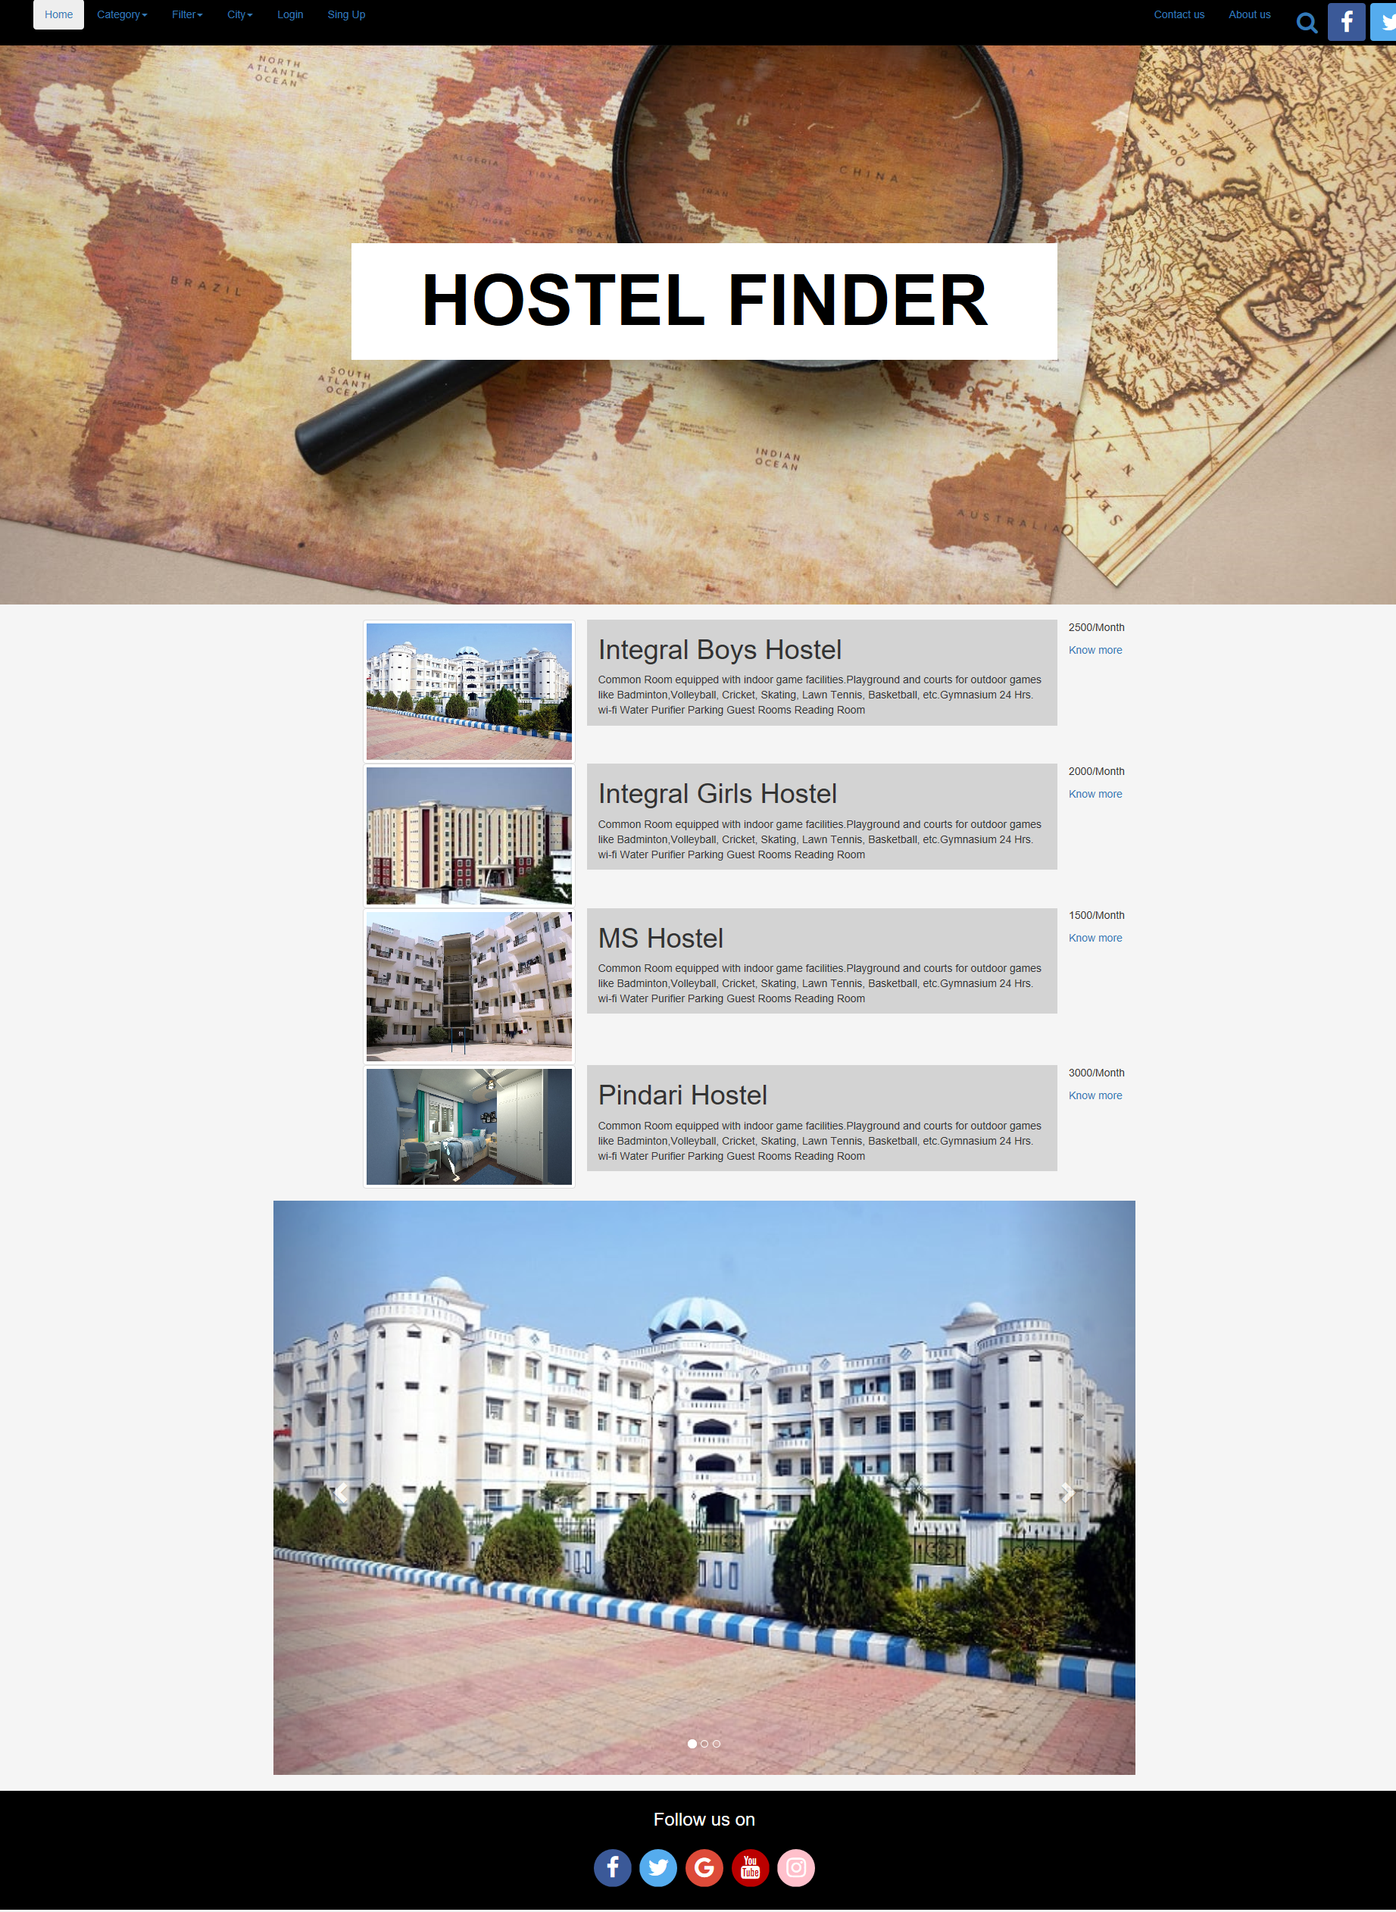
Home Pages

Slide 25
07
Future Scope
Hostel Finder

Slide 26
Future Scope
For the Future Scope of the Hostel Finder we will add :
01
Google Map API
02
Provide Payment Getway

Slide 27
THANKS
HOSTEL FINDER

